Slide 1
IPE 4111
Introduction to Management
COURSE TEACHER
- NUR MD. ALIF UL ISLAM
1

Slide 2


What is Management? Functions of Management Nature of Management Who are Managers?
Roles of Manager Management Theories
2

Slide 3
















Definition of Management
seeing that it is done in the best and cheapest way.
F.W.Taylor
actuating and controlling, performed to determine and accomplish
3

Slide 4





There are four such orientations have been adopted in defining the management process:
Production-or efficiency-oriented, Decision-oriented,
People-oriented, and Function-oriented.
4

Slide 5





Management is the art of knowing what you want to do and then
5

Slide 6


Decision-oriented Definitions:
Management is simply the process of decision making and
control over the action of human beings for the expressed purpose of attaining predetermined goals
6

Slide 7




People oriented Definitions:
is the accomplishment of results through the
efforts of other people
7

Slide 8




Function oriented Definitions:
manage is to forecast and to plan, to organize, to coordinate and
to
8

Slide 9


Management involves coordinating and overseeing the work activities of others so that their activities are completed efficiently and effectively.
9

Slide 10







Managerial Concerns
Efficiency
Getting the most output for the least inputs
Effectiveness
Attaining organizational goals
10

Slide 11
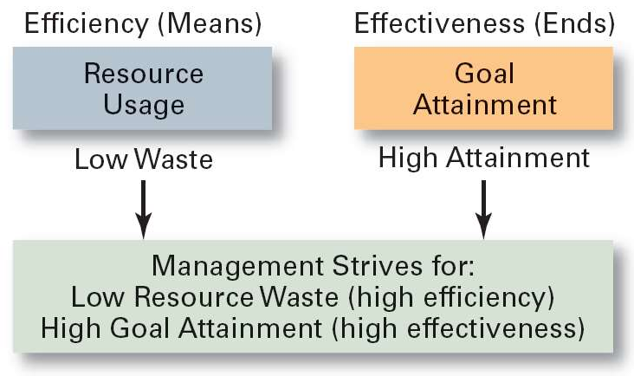
Effectiveness and Efficiency in Management
1 11

Slide 12



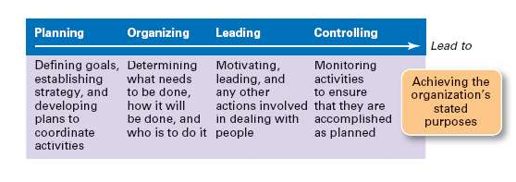
Functions of Management
12

Slide 13

1. Planning
It is a process of deciding the business objectives and charting out the plan/ method for achieving the same. This includes
Determination of what is to be done, how, and where it is to be done, who will do it and how result are to be evaluated.
Determination of long and short-range objectives. Development of strategies and courses of action to be followed
Formulation of policies, procedures and rules for implementing strategies and plans.
13

Slide 14

2. Organizing
Organizing involves:
Identification of activities required for the achievement of objectives and implementation of plans.
Grouping of activities so as to create self-contained jobs Assignment of jobs to employees
Delegation of authority so as to enable them to perform their jobs and to command the resources needed for their performance
Establishment of a network of coordinating relationships.
14

Slide 15

3. Staffing
Manpower planning: determination of no. of and the kind of personnel required.
Recruitments of suitable no. of employees Selection of most suitable employees Placement, induction and orientation Transfer, promotions & terminations
Trainings and developments
15

Slide 16


4. Directing
Directing involves communication, leadership and motivation.
Communication is the process of passing the information and understanding it from one person to other person.
Leadership is the function whereby the person or manager guides and influences the work of his subordinates.
Motivation is to motivate the employee to give their best to the organization.
16

Slide 17

5. Coordinating
Clear definition of authority-responsibility relationships Unity of direction
Unity of command Effective communication Effective leadership
17

Slide 18



6. Controlling
The controlling involves-
Establishing standards of performance.
Measuring current performance and comparing it against the established standard.
Taking corrective action that does not meet the standard. Control compels the events to confirm to plans.
18

Slide 19






LOWER LEVEL (FIRST LINE): FOREMEN & WHITE COLLAR
SUPERVISOR
MIDDLE MANAGEMENT: SALES MANAGERS, PERSONNEL
MANAGERS, OTHER DEPARTMENTAL HEADS
TOP MANAGEMENT: COMPANY PRESIDENTS, EXECUTIVES, VICE PRESIDENTS

Slide 20


Managers need a number of skills if they are to succeed. The most fundamental management skills are technical, Human, Conceptual, Design and time management skill.
- Technical skill: Technical skills are the skills necessary to accomplish or understand the specific kind of work being done in an organization. Project engineers, physicians, and accountants all have the technical skills. They get this skill from education and experience. Technical skills are especially important for first line managers. (Mechanics work with tools, so their supervisor should have the ability to teach them how to use the tools)
20

Slide 21

Human Skill:
For obvious reasons the manager needs interpersonal skills - the ability to communicate with, understand, and motivate individuals and groups. A manager must be able to work with subordinates, peers, and those at the top level also. They should also be able to work with suppliers, creditors, customers, investors and other outsiders.
21

Slide 22
Conceptual skills:
Conceptual skills depend on the manager’s ability to think in the abstract. Managers need the mental capacity to understand the overall workings of organization and its environment, to grasp how all the parts of the organizations fit together, and to view the organization in holistic manner.
22

Slide 23

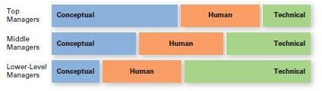
23

Slide 24


A role is a set of specific tasks a person performs because of the position they hold.
Roles are directed inside as well as outside the organization. There are 3 broad role categories:
Interpersonal
Informational
Decisional

Slide 25
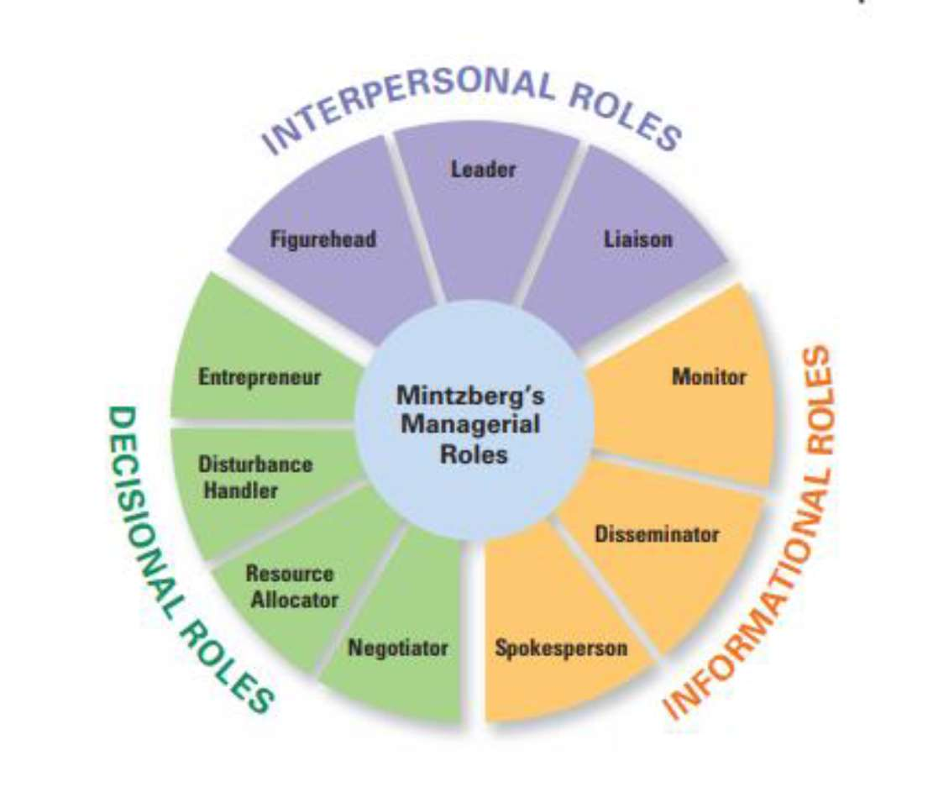
Roles of Manager

Slide 26

Roles managers assume to coordinate and interact with employees
and provide direction to the organization.
Figurehead role Leader role Liaison role

Slide 27

Associated with the tasks needed to obtain and transmit information for management of the organization.
Monitor role Disseminator role
Spokesperson role

Slide 28

Associated with the methods managers use to plan strategy and utilize resources to achieve goals.
Entrepreneur role Disturbance handler role Resource allocator role Negotiator role

Slide 29



Management is goal-oriented:
It is a means to achieve certain goals. Management has no justification to exist without goals. Management goals are called group goals or organizational goals. The basic goal of management is to ensure efficiency and economy in the utilization of human, physical and financial resources. The success of management is measured by the extent to which the established goals one achieved
29

Slide 30

Management is a Social Process:
Management is done by people , through people and for people. It is a social process because it is concerned with interpersonal relations.
Management is a Continuous Process:
Management is an unending process as past decisions always carry their impact for the future course of action.
30

Slide 31
Universal in Nature:
Management is universal in nature i.e. it exists everywhere in universe wherever there is human activity. The basic principles of management can be applied anywhere whether they are business or non-business organizations.
Multidisciplinary:
Management is basically multidisciplinary. Though management has developed as a separate discipline it draws knowledge and concepts of various other streams like sociology, psychology, economics, statistics etc.31

Slide 32
Dynamic:
Management is dynamic in nature i.e. techniques to manage business changes over a period of time. System of authority: Authority is the power to get the work done by others and compel them to work systematically. Management can not perform in absence of authority. Authority and responsibility depend upon position of manager in the organization.
32

Slide 33


- Mary parker, koontz & several others management authors called management an art of getting things done through people.
- Art refers to creative skills and talent which people required to conduct certain activities effectively.
33

Slide 34










Management is an art due to the following reasons:
Intelligence.
Initiative.
Innovation.
Individual approach.
Application and dedication.
Result oriented
34

Slide 35

Management as a Science
Science is a systematic body of knowledge that is universally accepted. Fredrick Taylor- the first person to consider management as a science, he was of the opinion that management should conduct their business affairs by following certain well-established standards.
Science can be broadly divided into two groups:
Physical science.
Social science.
Management is a social science because it deals with human beings.
35

Slide 36




Conclusion
-From the study above, we say that: management is both, art and science.
-According to ASME (American Society of Mechanical Engineers): is the art and the science of preparing, organizing and
directing human efforts to control the forces and utilize the material of
nature for the benefit of men.
-Management has got two faces like a coin; on one side it is art and on the other side it is science.
- is a mixture of an art and science the present ratio is about 80% art and 20% science. Dean Stanley.
36

Slide 37



The difference can be summarized under two categories:
Functions and Usage/Applicability
37

Slide 38





Basis | Management | Administration
Meaning | Management is an art of getting things done through others by directing their efforts towards achievement of predetermined goals | It is concerned with formulation of broad objectives, plans and policies
Nature | Management is an executing function | Administration is a decision-making function
Process | Management decide who should do it and how he should do it. | Administration decides what is to be done and when it is to be done.
Function | Management is a doing function because manager get work done under their supervision. | Administration is a thinking function because plans and policies are determined under it.
Skills | Technical and Human skills | Conceptual and Human skills
Level | Middle and Lower level function | Top level function
38

Slide 39





Basis | Management | Administration
Applicability | It is applicable to business concerns i.e. profit-making organization | It is applicable to non-business concerns i.e. clubs, schools, hospitals etc.
Influence | The management decisions are influenced by the values, opinions, beliefs and decisions of the managers | The administration is influenced by public opinion, government policies, religious organizations, customs etc.
Status | Management constitutes the employees of the organization who are paid remuneration (in the form of salaries and wages) | Administration represents owners of the enterprise who earn return on their capital invested and profits in the form of dividend.
39

Slide 40
1. What is management? Difference between Efficiency and Effectiveness
2. What major skill in needed in Top level manager
3. Administration vs management
4. Dynamic Management

Slide 41
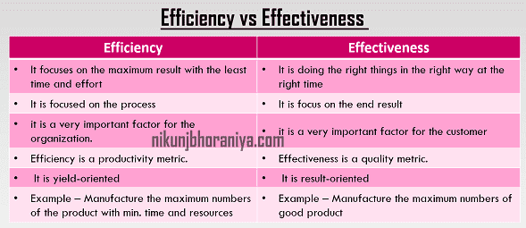
Comparison Chart
BASIS FOR COMPARISON | EFFICIENCY | EFFECTIVENESS
Meaning | The virtue of being efficient is known as efficiency. | The magnitude of nearness of the actual result with the intended result, is known as effectiveness.
What is it? | Work is to be done in a correct manner. | Doing accurate work.
Emphasis on | Inputs and Outputs | Means and Ends
Time Horizon | Short Run | Long Run
Approach | Introverted | Extroverted
Ascertainment | Strategy Implementation | Strategy Formulation
Orientation | Operations | Strategies

